Slide 1

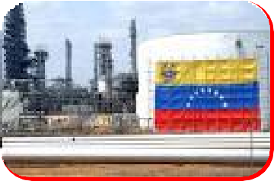
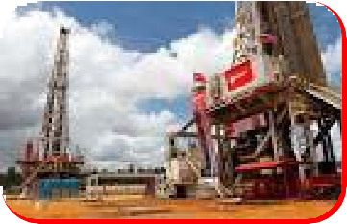
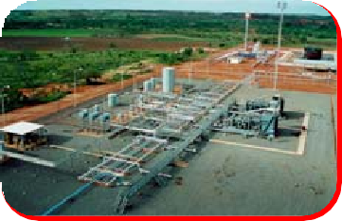
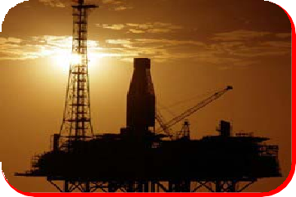

GERENCIA DE EXPLOTACION DE YACIMIENTOS APURE
SUMARIO MENSUAL DE PRODUCCIÓN POR POZOS
DIVISIÓN APURE AGOSTO 2025
Revisado por: Jennyfer Cegarra Gerente Yacimientos
División Apure DEPLLL.
Aprobado por: Johan Gómez
Gerente General (E) División Apure
Aprobado por: Gustavo Padrino
Director Adjunto (E) DEPLLL.

Slide 2


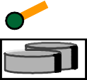

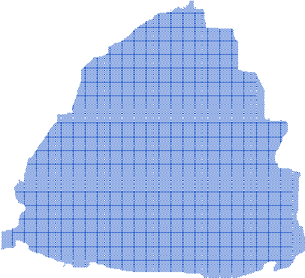





CAMPO GUAFITA UBICACIÓN DE POZOS
PLANTA GUAFITA Feeder 1 (21): (280 A) (6,4 MW)
Q2,Q4,Q6,Q8,Q10 (Q2=46 A, 1 MW) (Q4 y Q6= 88 A, 2,0 MW) (Q8=92 A, 2,1 MW) (Q10=54 A, 1,2 MW)
CAÑO LA COLORADA
ESTACIÓN
R
GUAFITA
Cluster-2: GF- 2X , 42, 73,110, 210,
(119)
PLANTA GUAFITA Feeder 2 (41): (412 A) (9,5MW)
Cluster-59: GF-81
Q1,Q3,Q5,Q7 (Q1=55 A, 1,2 MW) (Q3=124 A, 2,8 MW)
,
(Q5=117 A, 2,7 MW) (Q7= 113 A, 2,6 MW)
R
Cluster-16:GF-16
Q1 Cluster-104: GF- 127
RECONECTADORES:
Cluster-3:
Q6
Q2
Cluster205: GF- 205,
209, 213, 214, 215,
216, 227, (220)
S/E GF NORTE = Con Q4 y Clúster GF – 3 = 276 A Con Q4 = 245 A, Sin Q4 y GF- 3 = 195 A
GF – 45 = 110 A (GF Norte)
GF – 69, 95 y 97 = 68 A (Q7)
GF – 37 y 78 = 100 A (Q7)
GF – 5 = 70 A (Q10)
GF – 14 = 31 A (Q3)
GF – 19 = 40 A (Q8)
GF – 61 = 74 A (Q8)
GF – Q4 = Solo Q4= 65 A Q4 y GF-3 = 95 A
GF-125,131,(126) _{Cluster96:GF- 96,}
102, 106, 120,
(182,117,194)
Cluster-39: GF- 99, 100 (39,40, 60,
218)
Q5
Cluster-32: GF- 44, 54, 143, (33, 34, 43)
Cluster93:
GF-93, 128, 223,
Cluster-71: GF- 74, 225,
228, (141, 142, 189,221)
Cluster-57: GF- 111, (57, 65)
Cluster-1: GF - 1X,(36,46,181)
Cluster-91: GF-(91)
Cluster-4, 88,109,(49)
Q6
EST GF-1X
Cluster-77: GF-77;(108)
Cluster37: GF- 38,112,
R
R
123, 151, 152, 177, 200,
206, 207, 217, 224, 183,
Cluster95: GF-95,
Cluster-78: GF-78, 87, 140, 161,191
187, (56, 92, 147)
Cluster-69: GF-114
Cluster97: GF-97, 158, Q7
(129, 139, 144, 160)
178, 197, (124, 197)
LAGUNA LA YUCA
Cluster-154: GF-154, 155, 157, 162,
164, 203,(165, 166,171,202)
Cluster-7: GF-,38,146, 150, 169,
CLUSTER-11, GF- 80, 107(85,101)
R
175, 192, 199, 204, 208, 226, 180,
(7, 30, 48, 167, 173, 185, 186, 212)
Cluster-13: GF- 29, 79, 83,
133, 138,172, 211, (18, 22, 24,
27, 51, 55, 76, 113, 121, 163,
229)
Cluster-19, 26, 35,
Q10
Q8
(20, 28, 50, 58)
Cluster-5: GF-, 21,148, 149, 153, 176,
198, 201, 222, (23, 25, 47, 145, 179)
Cluster-10, 98(82,84,103,105)
Q3
R
R
Cluster-14: GF- 31,
170, 174, (17, 52, 159)
R
Cluster-188: GF- 193, (190, 195)
Cluster-61:GF-62, 64, 70, 90
,134, 156, 137, (63,67, 75, 86,
cluster-66:GF- 66,
68, 89, (72, 136)
Actualizado por Operaciones de Producción 11/02/2015
José Omar Cravo
94, 116, 118, 132, 135, 219)
CAÑAFISTOLA
R I O
C O L O M B I A
A R A U
C A

Slide 3


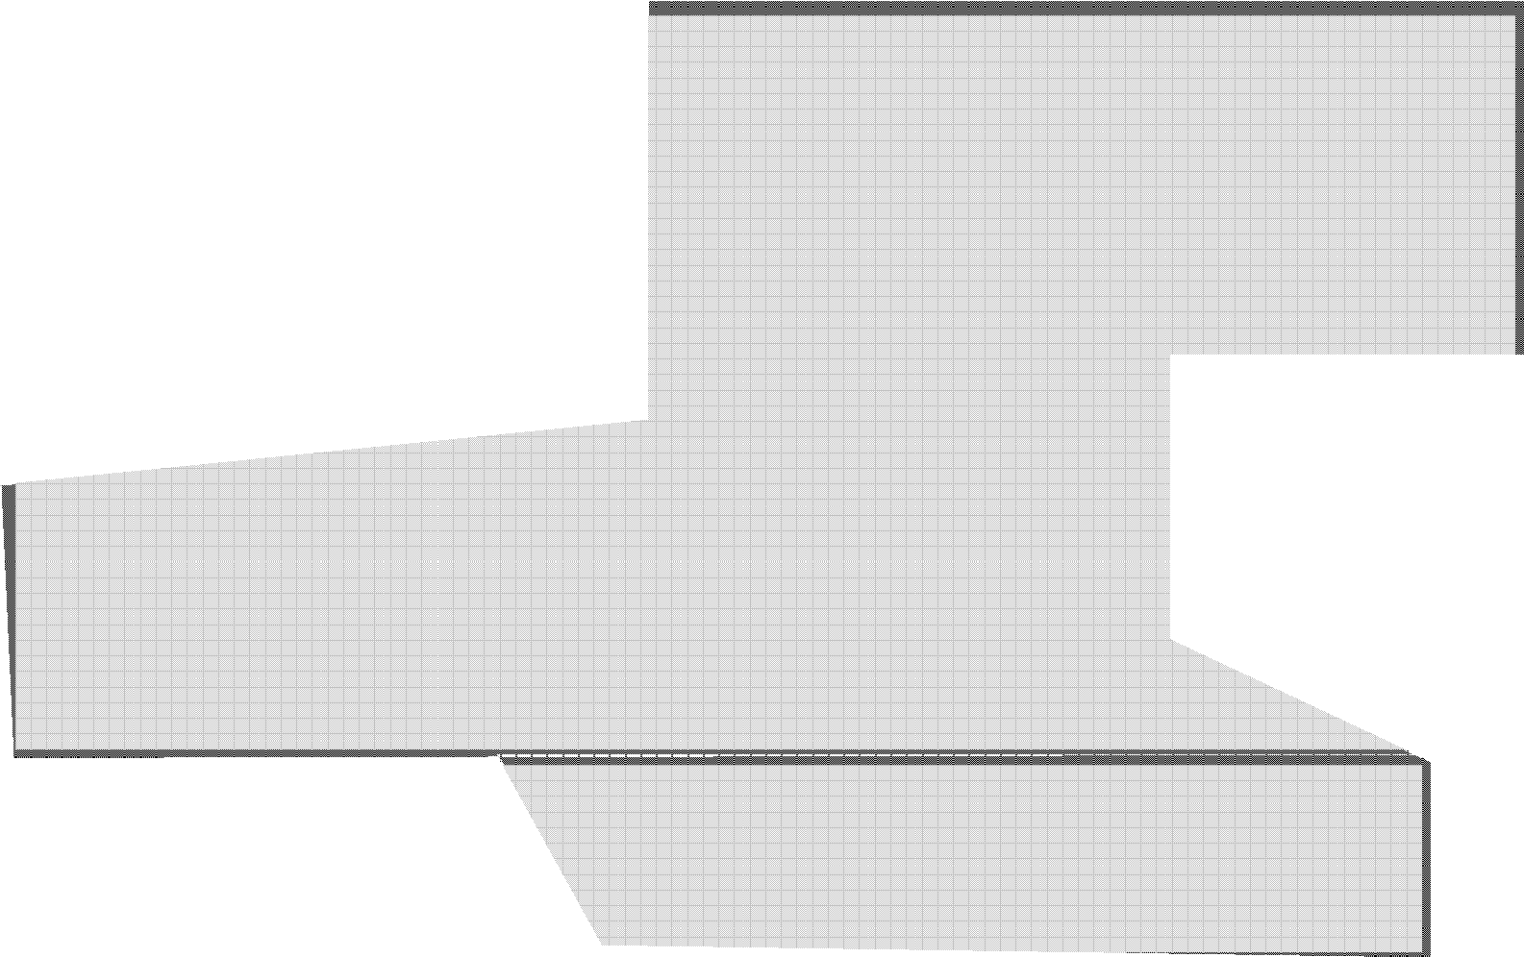






CAMPO LA VICTORIA UBICACIÓN DE POZOS POR CIRCUITO
Cluster 8 LVT-
51,52,53,54,55,58,59,63
Cluster 2
LVT- 10, 11, 12, 13, 14,
16, 17, 18, 20, 26, 15,32
Cluster 1 LVT-04,07,08,
VÁLVULA MULTIPUERTO CLUSTER 6
V.M-P
V.M-P
09,19,40
Fluyen: 38,40,49
Est. LVT
Q3 TURBINAS
Q2 MODULO
Cluster 4
LVT-30, 28,37
Cluster 7
LVT-45, 47, 48, 50
Cluster 5
LVT-34,36,39,46,56,57,60,62
CADAFE
Cluster 3
LVT-21, 22, 23,
LVT-1X
41, 42, 43, 44
27,61

